Slide 1
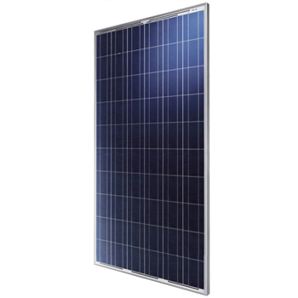
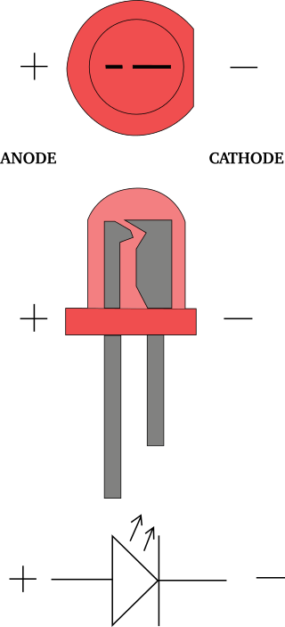
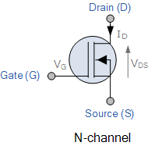
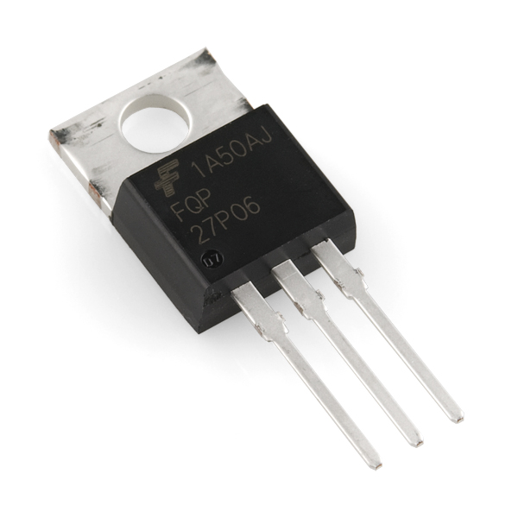
Semiconductor Devices
Solar Panels
Diodes and LEDs
Transistors

Slide 2
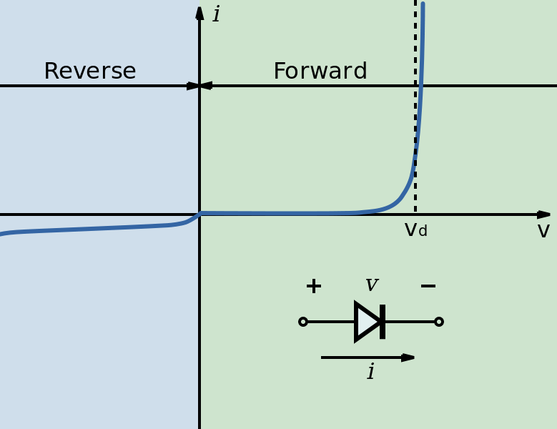
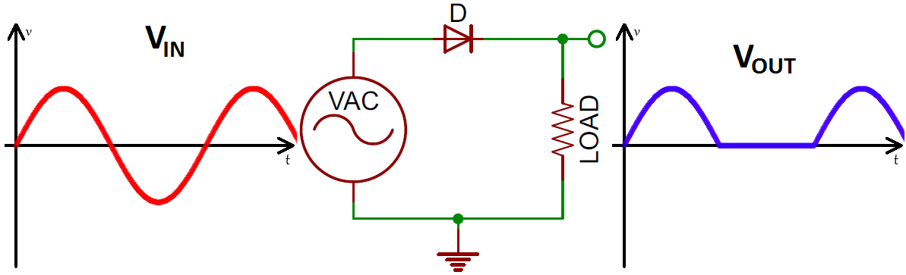
Diodes
A diode is a semiconductor device that only allows current to flow in one direction.
Rectification

Slide 3

Transistors
Used for Amplifiers and Logic Circuits
MOSFET
BJT
www.en.wikichip.org

Slide 4
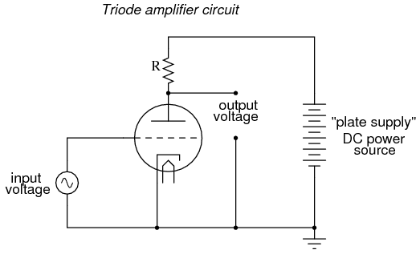
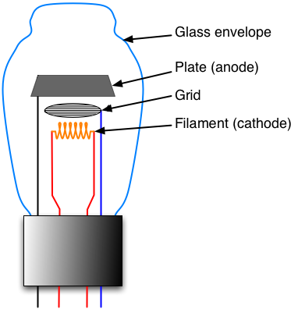
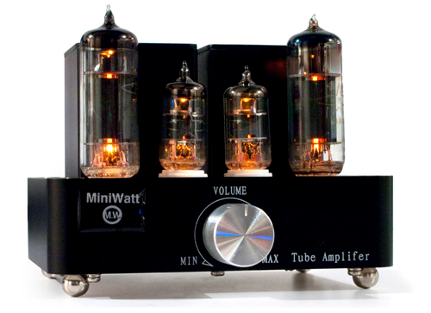
Vacuum Tube Amplifiers

Slide 5

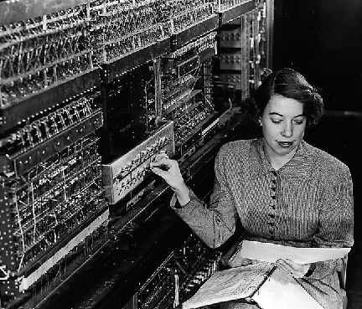
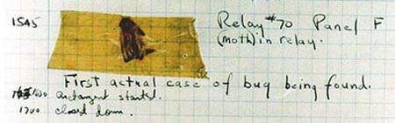
Electronic Numerical Integrator And Computer (ENIAC)
Built by the US Army in 1946.
17,468 vacuum tubes!
Computer programs used to actually contain bugs!
https://en.wikipedia.org/wiki/ENIAC

Slide 6
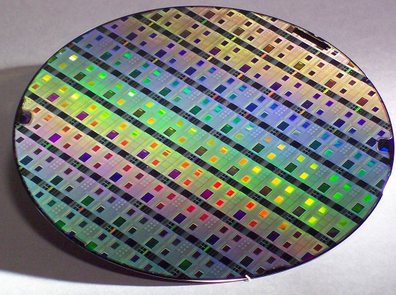
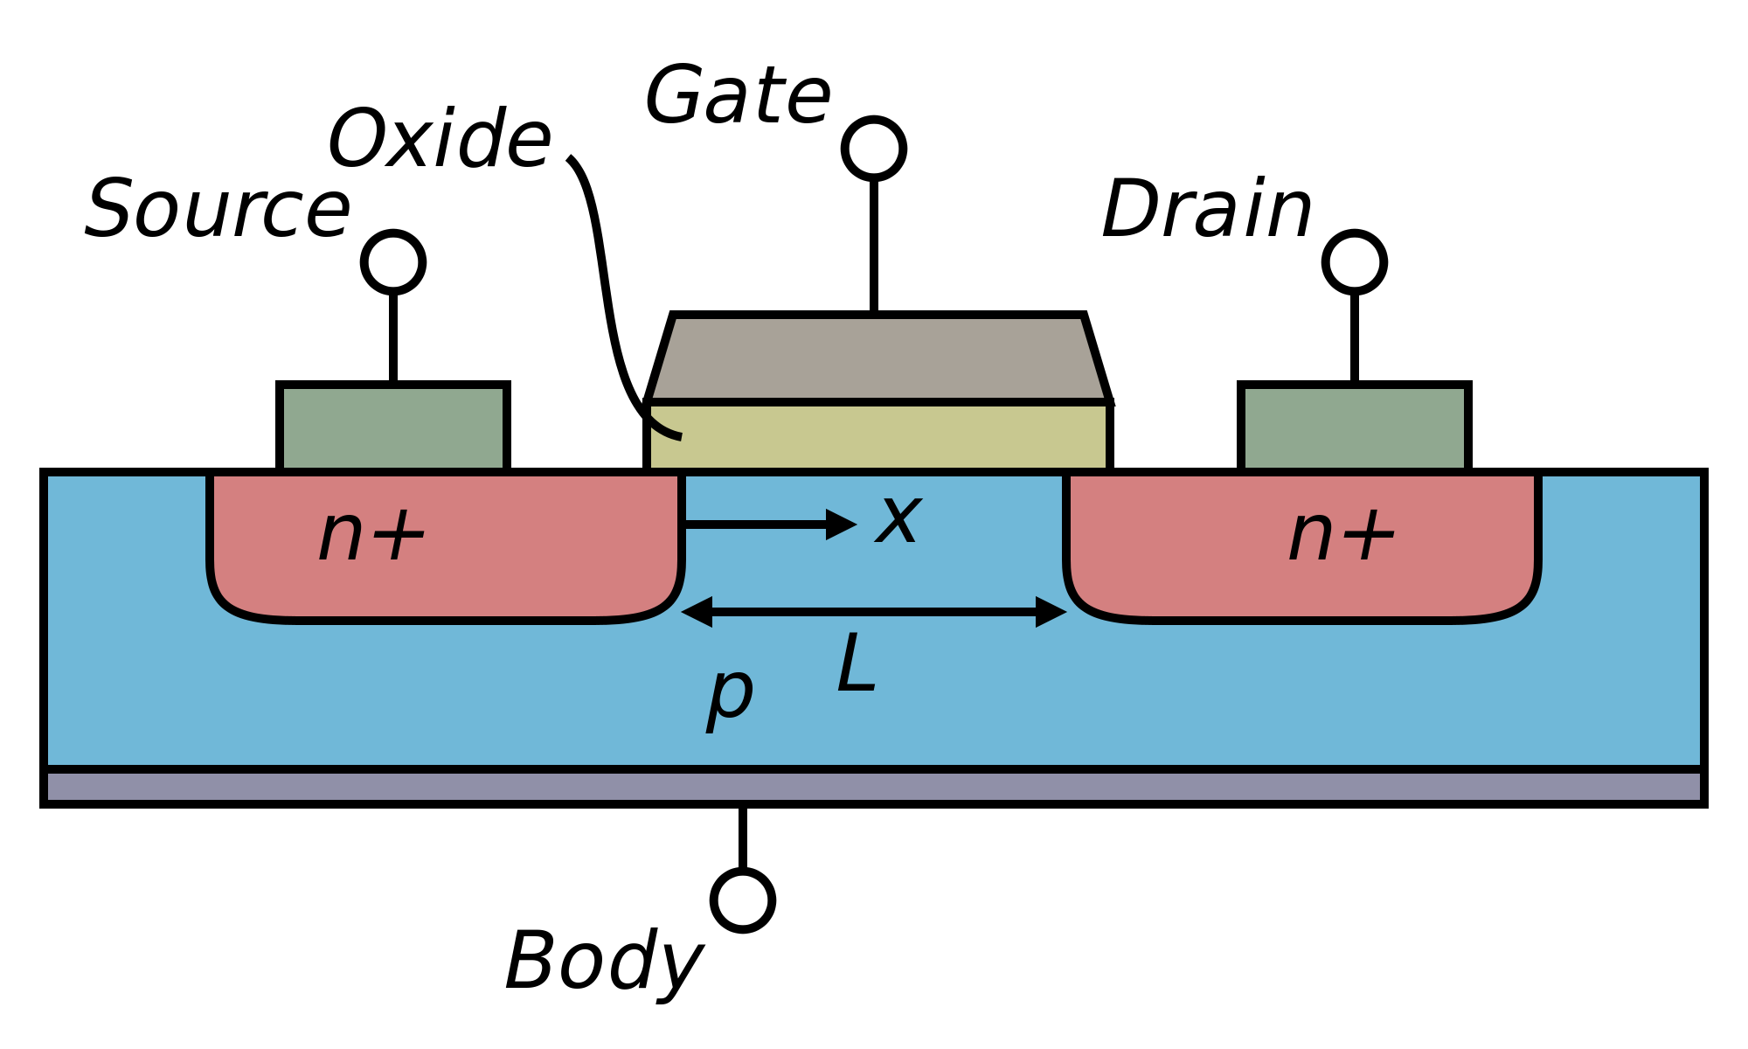
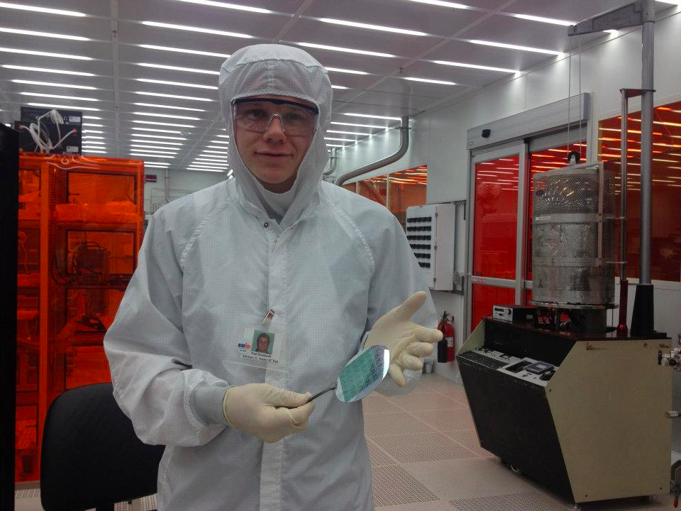

Integrated Circuits (I.C.s)
Solid state transistors can be fabricated en masse on a silicon substrate!
https://en.wikipedia.org/wiki/MOSFET

Slide 7
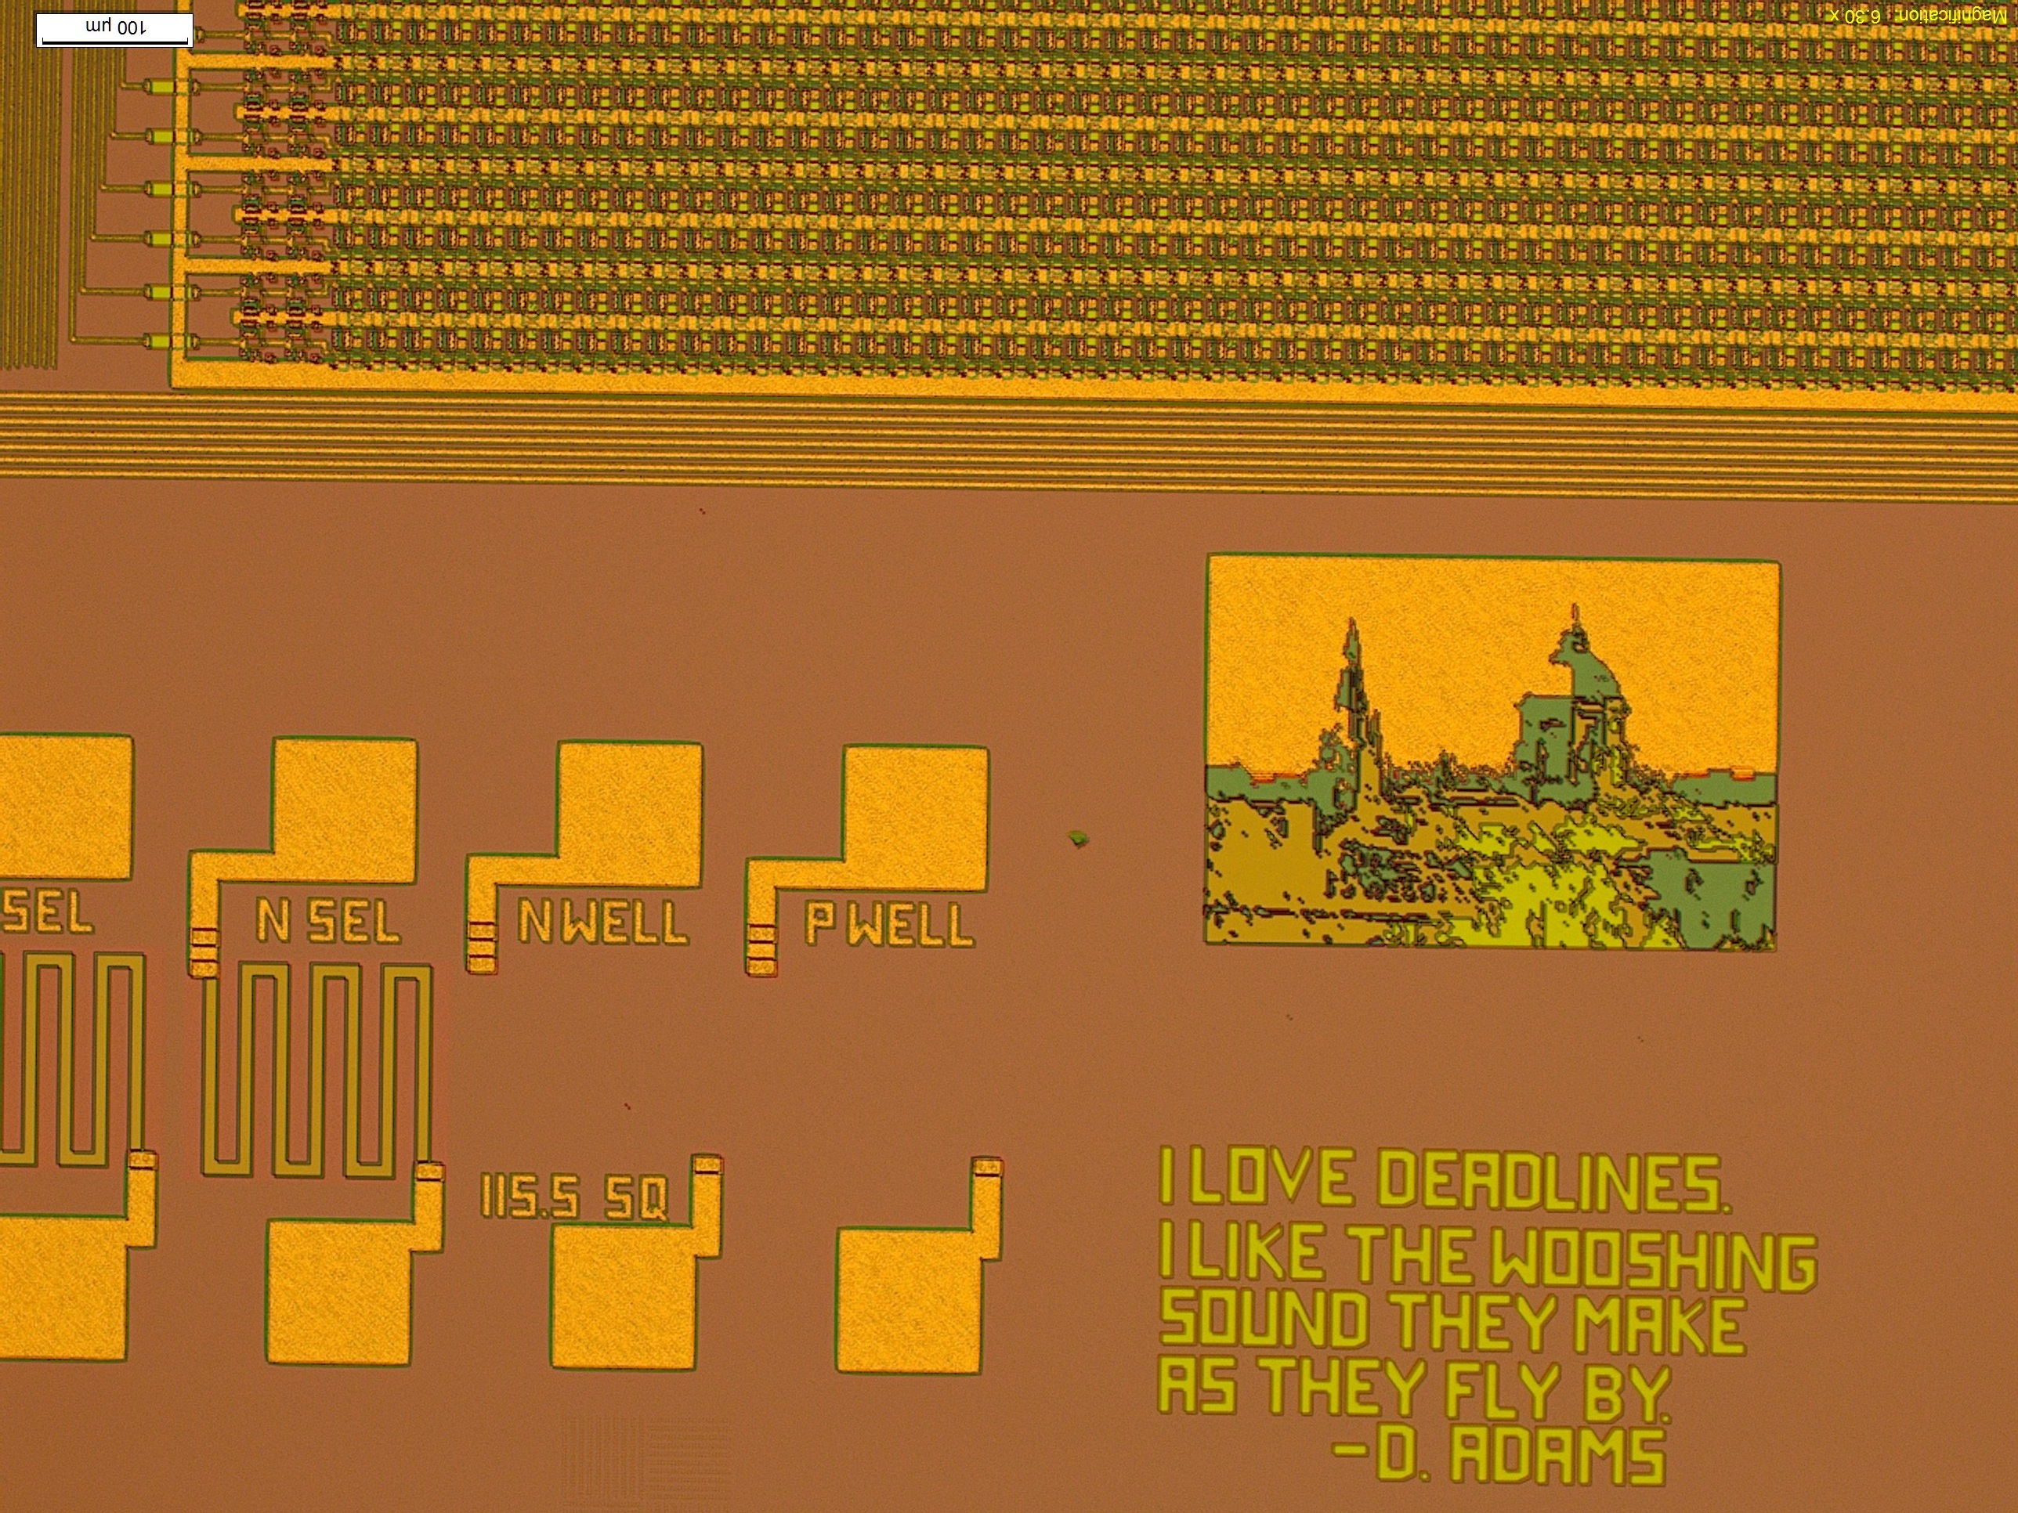
Integrated Circuits (I.C.s)

Slide 8
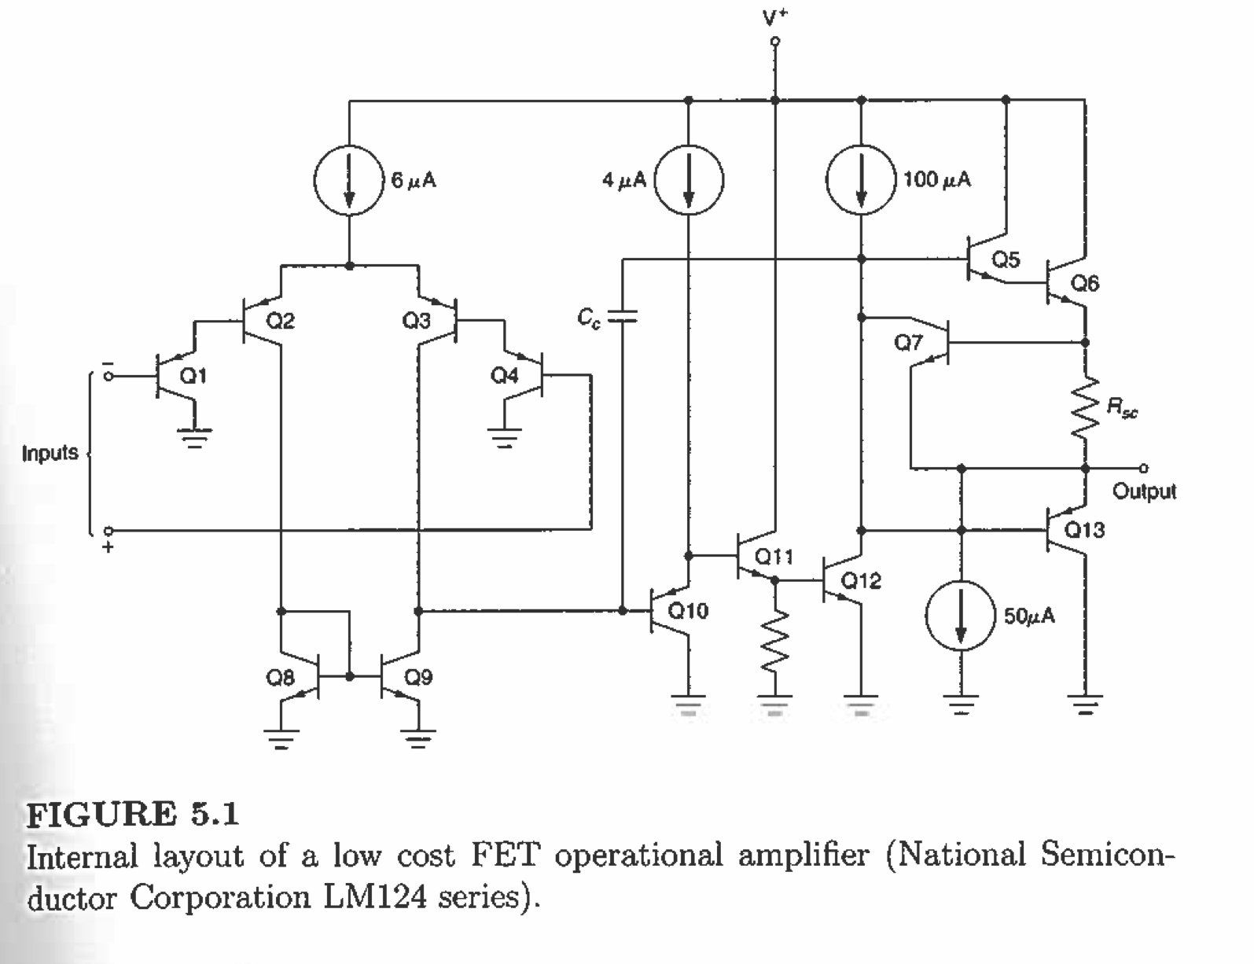
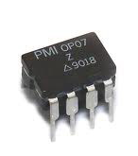
Op-Amp Integrated Circuit

Slide 9
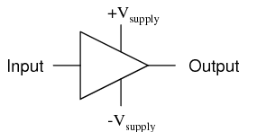
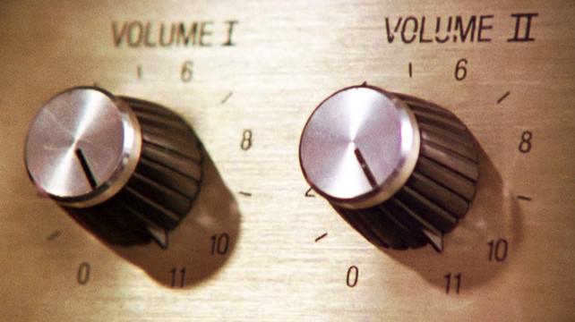
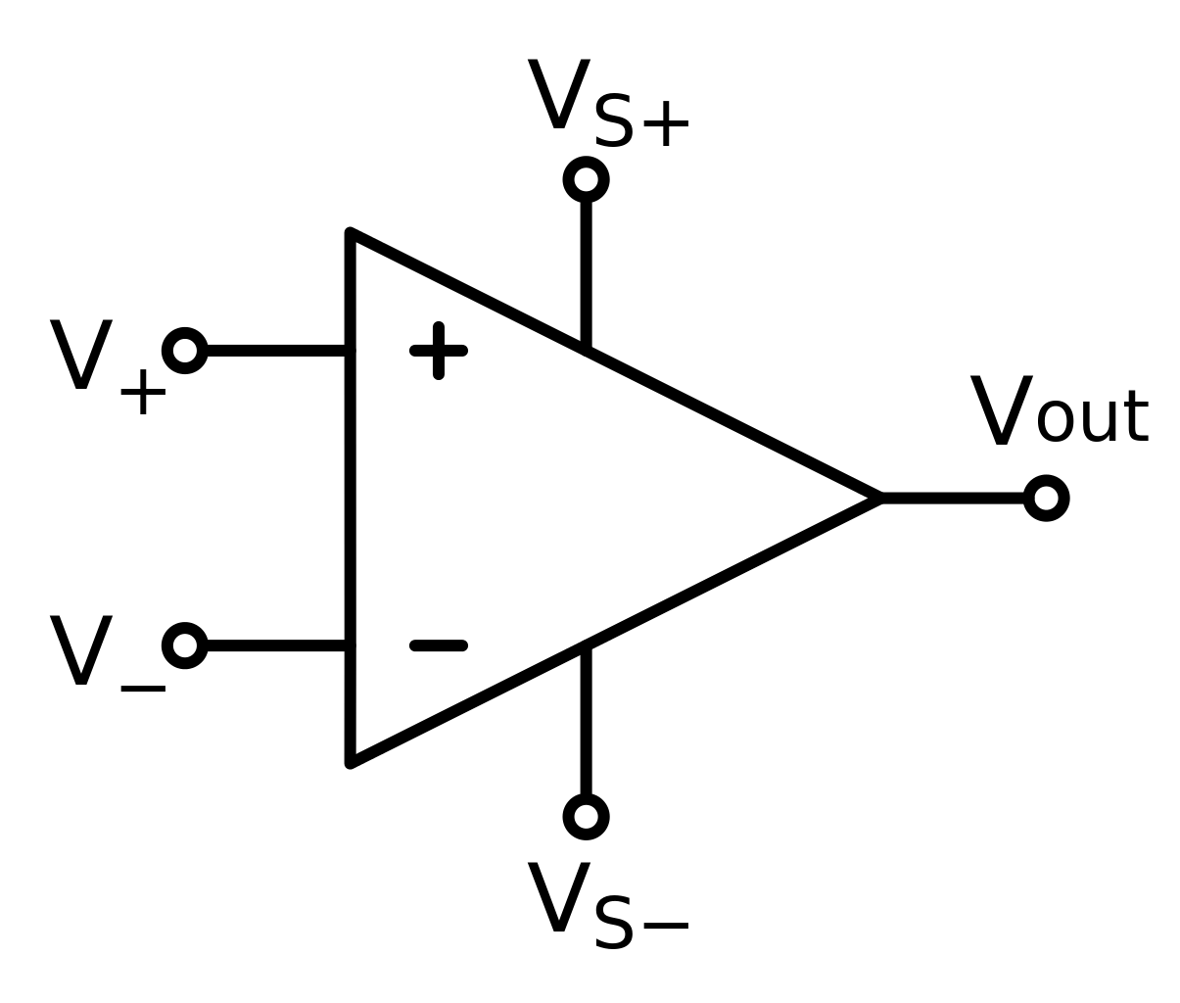
Amplifiers
Used to increase the signal-to-noise-ratio (SNR).
“Gain”
“The numbers all go to eleven.”
Differential Amplifier cancels out the “common” noise, only amplifies signal.

Slide 10
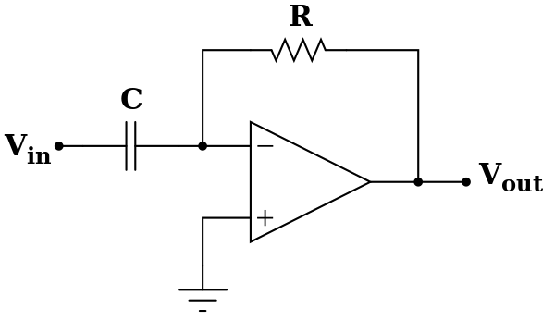
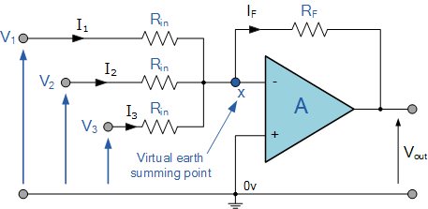
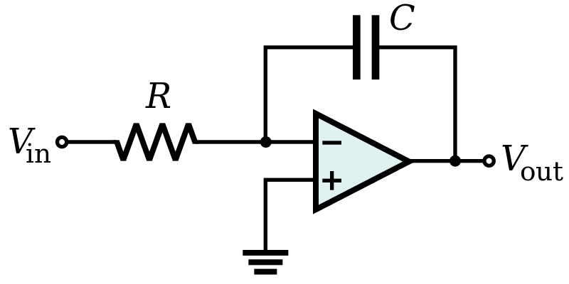
Op-Amps and Analog Computers
Analog computers – a number is represented as a single voltage
Differentiator
Summing amplifier
Integrator
http://www.electronics-tutorials.ws/opamp/opamp_4.html
https://en.wikipedia.org

Slide 11
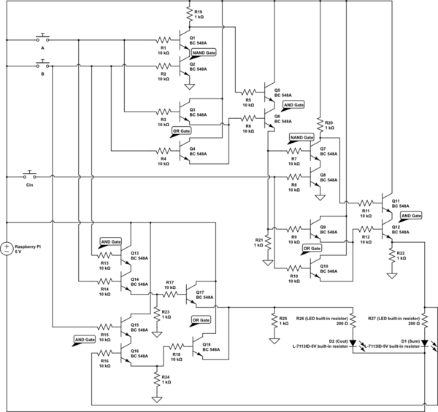
Digital Logic Circuits – 2 bit adder

Slide 12
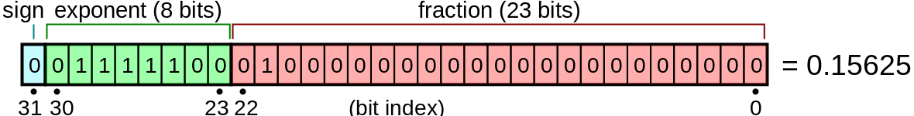
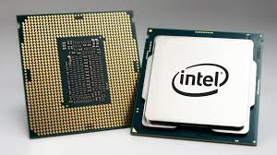
Analog vs. Digital
Analog computer – A single number is represented by a single voltage.
Digital computer – A single number is represented by many voltages that form a “binary code”
Integrator
Differentiator

Slide 13
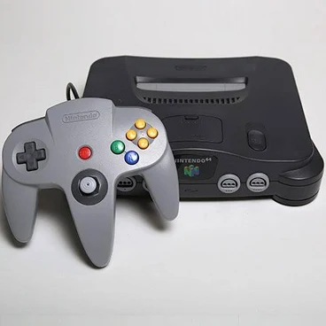
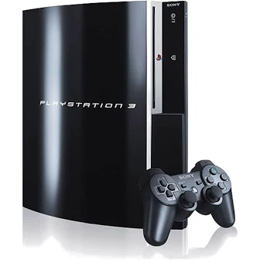
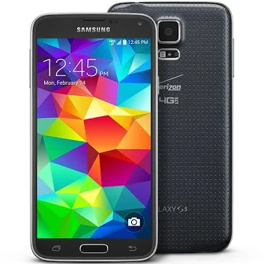
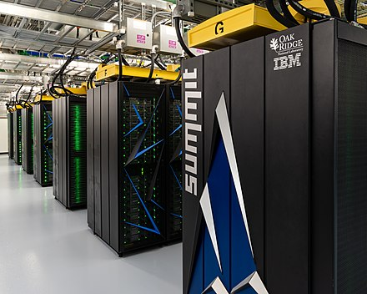
Digital Computers
FLOPS – Float Point Operations Per Second
Nintendo 64 ~ 10⁸ FLOPS
PS3, Samsung Galaxy S5 ~ 10¹¹ FLOPS
IBM Summit supercomputer ~ 10¹⁷ FLOPS

Slide 14
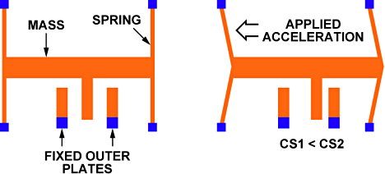
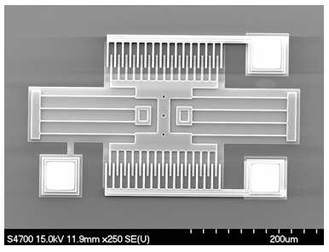
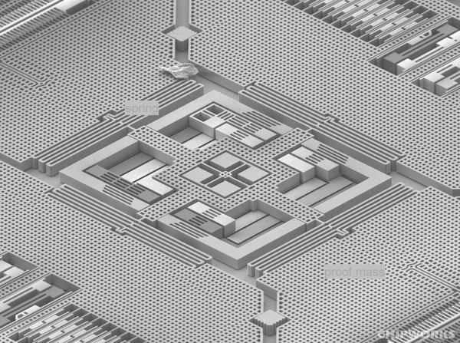
MEMS Accelerometers
Acceleration causes mass to push on spring and displace the “interdigitated” electrodes,
changes electric capacitance.
Micro-Electro-Mechanical Systems (MEMS)
3-axis gyro from an iPhone 4

Slide 15
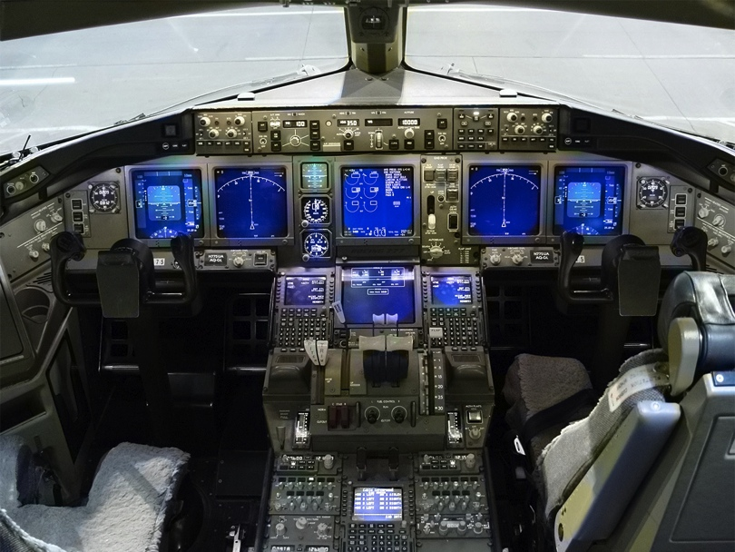
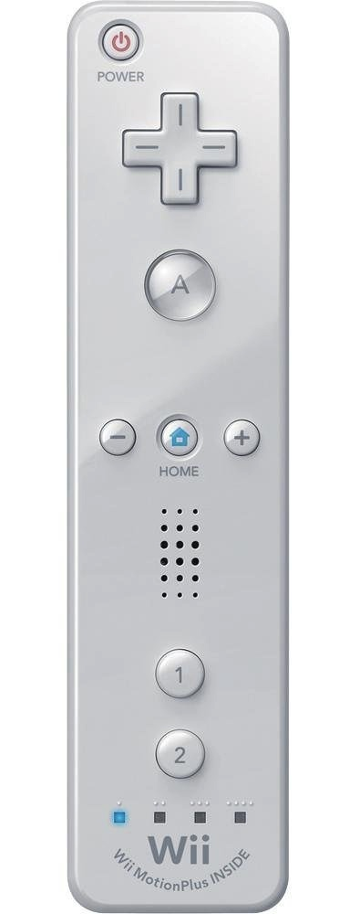

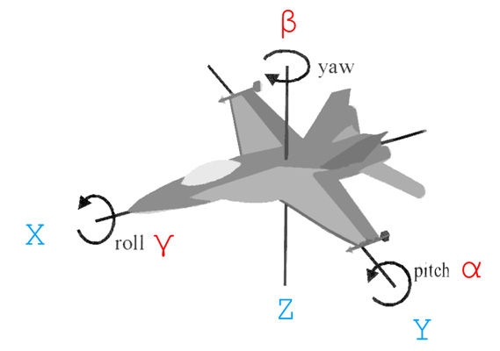
Accelerometers
Boeing 777 glass cockpit.

Slide 16
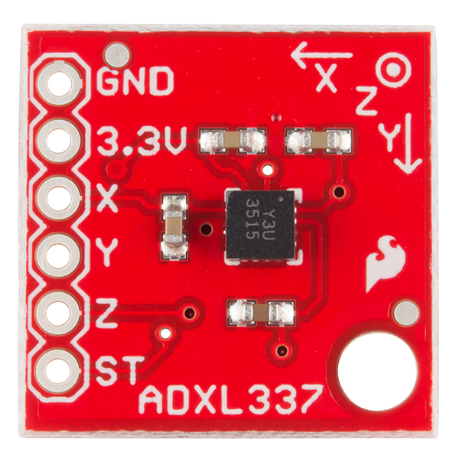
ADXL337 – MEMS Accelerometer
3-axis Accelerometer. Analog sensor outputs voltage linearly related to acceleration.
acceleration
output voltage
-3g (-30 m/s²) ---> 0V
+3g (+30 m/s²) ---> 3V

Slide 17
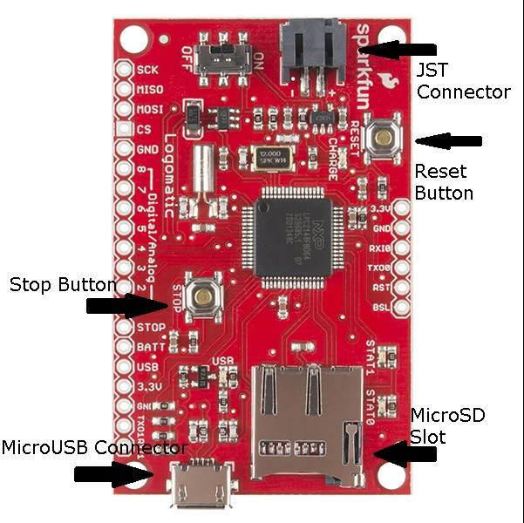
SparkFun Data Logger
10-bit Analog-to-digital converter (A/D). Saves voltages to a MicroSD card.
analog
voltage
10-bit
digital
0V ---> 0
3V ---> 1023

Slide 18
2-point Calibration
2-point calibrations of the system are performed by rotating the sensor about its axes.
a_{y} = +1g (9.8 m/s²)
a_{y} = -1g (-9.8 m/s²)

Slide 19
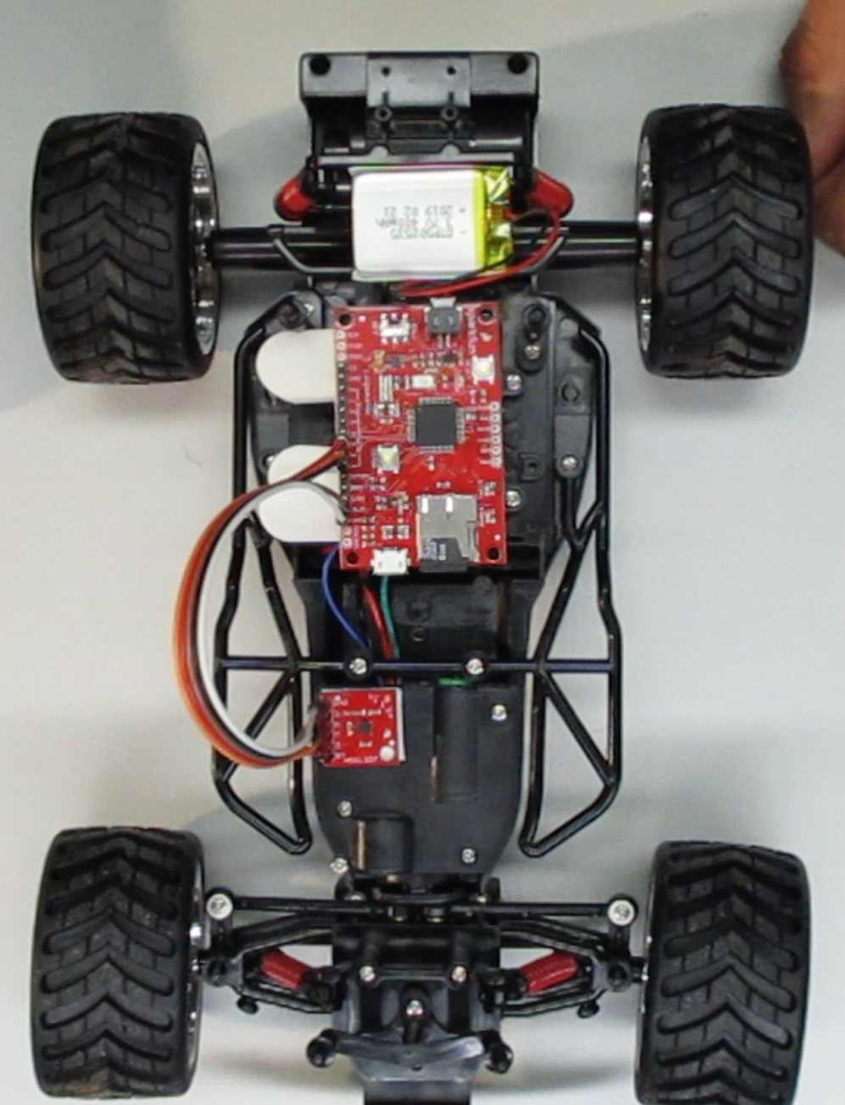
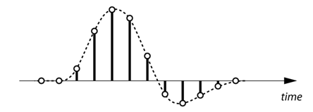
Telemetry of an RC Car
Acceleration data will be recorded at a sampling frequency f_{s} = 50 Hz.
Important: See “Data Processing” section of A9 lab handout.

